Slide 1
VALUE-BASED SALES
Basic Principles
Rick Struzynski

Slide 2
AGENDA
  Learning Expectations
  Common understandings & definitions
  Buying Process
  Value Proposition
  Value-Based Pricing

Slide 3

LEARNING EXPECTATIONS
  What are we going to get out of this presentation?
    We are NOT going to become "perfect" salespeople from this presentation
  We will get a better understanding of who our customers are
    And what drives them
  We will also get a better understanding of what value is and how to quantify value

Slide 4
WHAT IS
VALUE-BASED SALES?
  It goes by many different names:
    Consultative Sales
    SPIN Sales (situation, problem, implication, need-payoff)
    Solution Selling
    Investigative Sales
  It is really about asking the right questions and quantifying intangibles

Slide 5
WHO ARE OUR CUSTOMERS?
How many....
    Airplanes has United leased?
    Cars has Hertz bought?
    Microprocessors has Dell bought?
Trick question - None!
Companies don't make purchases - people do

Slide 6
WHO ARE OUR CUSTOMERS?
  They are people, not companies
  They each have unique needs - some may be obvious, some not
  Until we understand the real drivers, we are just playing a game of chance
    Assume your competition is meeting the stated scope - Have you ever lost a bid even though you were the lowest price?
      Playing the "price war" is a losing proposition

Slide 7
WHAT IS VALUE?
“In the sales process value is most clearly and measurably defined as
that which the customer will take action to obtain or keep”
- Michael J. Webb, Sales and Marketing the Six Sigma Way

Slide 8
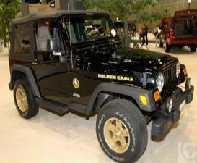

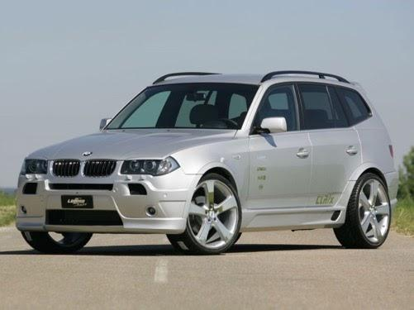
MY STORY
How did I go from this ............... to this?
...and why would you be confused if you were the Jeep salesman?

Slide 9
MY STORY
Because you never took the time to find out what my real drivers were.
You only knew that I had an immediate need and was a very satisfied previous Jeep owner.
In reality, you never had a chance because my wife hated the look of the Wrangler and her opinion far outweighed my desire for the Jeep.

Slide 10


THE BUYING PROCESS
1. Problem Recognition
2. Information Search
3. Evaluation of Alternatives*
4. Purchase Decision
5. Purchase
*This is the RFQ stage - If you are just finding out about the opportunity at this stage, your success is left to chance – you have no control.
6. Post Purchase Evaluation

Slide 11
THE BUYING PROCESS: STAGES
  1. PROBLEM RECOGNITION
4. PURCHASE DECISION
  Cost Reduction
  Process improvement
  New Market
  Etc...
  Who best meets the stated and unstated criteria
  How much "value" is placed in the intangibles
2. INFORMATION SEARCH
5. PURCHASE
  Web
  Tradeshow
  Sales Rep
  Etc...
  T's & C's
  Delivery
3. EVALUATION OF ALTERNATIVES
6. POST PURCHASE EVALUATION
  References
  Site Tours
  Quotes (includes a quality value proposition)
  Service support
  Product/Service/Technology performance

Slide 12
VALUE PROPOSITION
  What is a value proposition?
    Do all products/services have a value proposition?
    Is it one size fits all?
  Yes and no!
    Yes – all goods/services must provide value
    No – generally, there is no single proposition for all customers

Slide 13
SO… WHAT IS A VP?
  What is a value proposition?
    “A clear statement of the tangible results a customer gets from using your products or services”
    - Selling to Big Companies, Jill Konrath
  As all customers have different needs, a VP must be custom-tailored to each buyer to be truly effective.

Slide 14
VALUE PROPOSITION
  This is where ”investigative sales” comes in
  Must have a good relationship
  Fill in the “non-RFQ” blanks

Slide 15
DEVELOPING A VALUE PROPOSITION
  What are the key issues facing the business/individual?
    SWOT analysis, background research, information gathering, etc.
  What is the impact of those issues?
    Cost, time to market, process improvement, etc.
  How can we help?
    What products or services are appropriate?

Slide 16
DEVELOPING A VALUE PROPOSITION
  What are the potential benefits?
    This is not about features, but tangible answers to the identified problems
  Prove it!
    Cite examples

Slide 17
DEVELOPING A VALUE PROPOSITION
You will develop a 1-2 sentence statement that clearly addresses the critical decision criteria and how your solution answers those needs.

Slide 18
Value-Based Pricing

Slide 19
VALUE-BASED PRICING
  What is the typical pricing strategy? Why?
    Cost plus is most common – why?
      It’s easy, but how often is the ‘easiest’ way the best way?
  Value-based pricing (VBP) attempts to quantify everything we’ve just discussed.
  Works with utility function

Slide 20
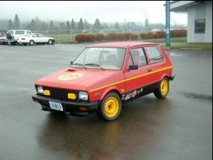
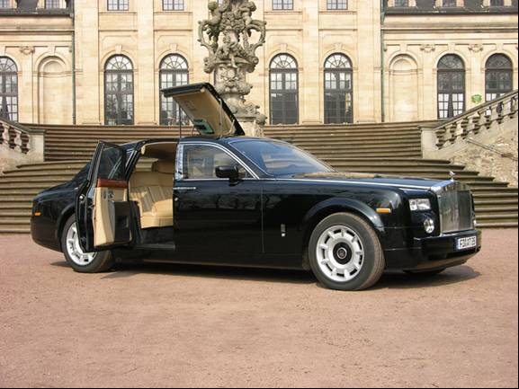
VBP: Example
$380,000
$3,990

Slide 21
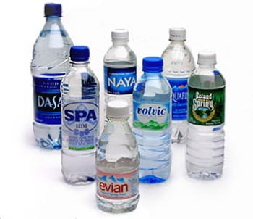

VBP: Example
0.033 cents/ml
0.6 cents/ml
Same water in airport

Slide 22
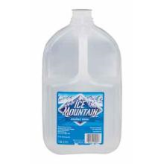
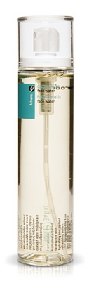
VBP: Example
0.238 cents/ml
Distilled Water
21 cents/ml
98% distilled water

Slide 23
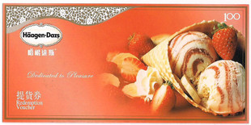
REAL WORLD EXAMPLE: CHINESE MARKET
What is the value of a ¥100 coupon?

Slide 24
REAL WORLD EXAMPLE: CHINESE MARKET
Häagen-Dazs prints millions of ¥100 coupons
  Cost – so small relative to the other numbers – free
HD then sells them to an intermediary
  HD wants to deal in volume, not 100-200 or so
  HD sells them for ¥80
Intermediaries then sell to Employers
  Value received: ¥20
Employers give to staff
  Value received: goodwill – unknown

Slide 25
THE VALUE CHAIN CONTINUES…
Some staff use directly, chain over
  Value received: ¥100 + unknown goodwill
Many employees give coupon away
  Value received: Guanxi (unknown goodwill)
Some receivers use directly
  Value received: ¥100 – unknown goodwill
Many receivers sell to coupon marketers¹
  Typically 40% face value
  Value received: ¥40

Slide 26
THE VALUE CHAIN CONTINUES…
Coupon Marketers need to do something…
  Easiest solution?
  SELL BACK TO HÄAGEN-DAZS!
  HD happy to pay ¥50
  Value received: ¥10
Häagen-Dazs – the cycle ends
  Coupon shredded
  Value received: ¥30 + unknown goodwill

Slide 27
LET’S REVIEW
Tangible value received:
  HD: ¥30 (¥ 80 – ¥50 – initial investment [0])
  Intermediary: ¥20
  Employee (small % use directly): ¥100
  Receiver (small % use directly): ¥100
  Receiver: ¥40
  Coupon marketer (small % use directly): ¥100
  Coupon marketer: ¥10
  Total tangible value²:
    30+20+10+9+36+8.1+7.3 = ¥ 120.4
Goodwill value received:
  Häagen-Dazs
  Employer
  Employee (most)

Slide 28
NOTES
There is a very active aftermarket for coupons in China. It is very common for coupon holders to sell a coupon they don’t want/need in exchange for something more useful (at least at the time).
Discounts calculated as follows:
  Assume about 10% of employees use coupon directly – therefore realized value of ¥10
  Assume about 10% of receivers use coupon directly – therefore realized value of ¥9 (10% of 90% from step one)
  If 10% of receivers use coupon, resale value must be discounted - realized value of ¥36
  Assume about 10% of coupon marketers use coupon directly – therefore realized value of ¥8.1
  If 10% of marketers use coupon, resale value must be discounted – realized value of ¥7.3

Slide 29
CONCLUSIONS
Our customers are people, not companies, and likely have hidden needs
It is our job to bring value to each stage, helping customers move through the buying process
A value proposition answers customer specific needs
Value based pricing is a useful negotiation tool
Value comes in all shapes, forms & sizes!

Slide 30
Thank you
Choose Growth
1.224.236.2707
rick@choosegrowth.us
https://salesgrowthplans.com/

